Slide 1
How many words is a picture REALLY worth?
Filtering datasets using image-captioning neural networks
Nerds of a Feather
(Aditya, Gauri, Karishma, Owais, Rubin)
Notes:
Hi
Our project works around the idea of captioning images using neural networks

Slide 2
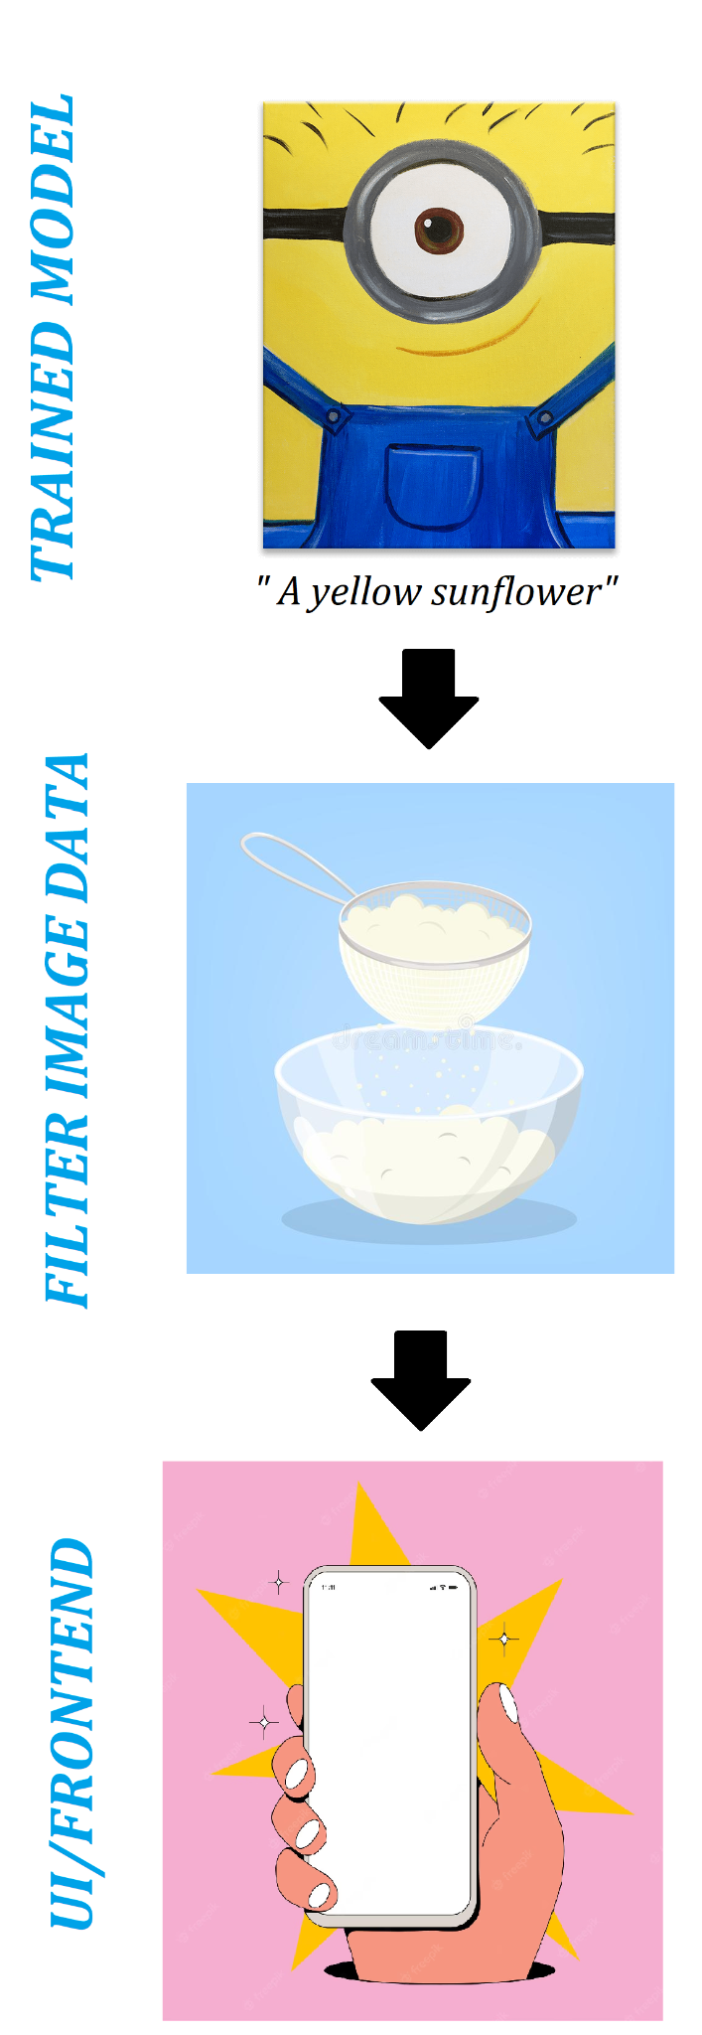
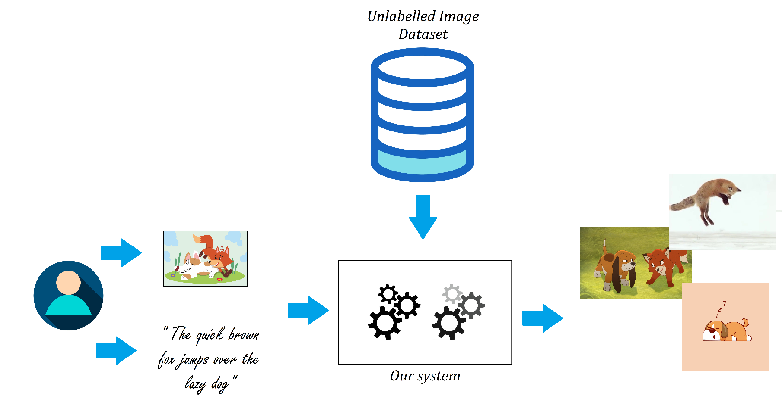
The ‘what’?
Notes:
So…the user can provide either an image or a phrase
Our system extracts human-readable tags from the images. Features with NLP for the phrase.
Three main components:

Slide 3
The ‘why’?
Motivation
The big picture: benefits of auto-captioning for making reading material accessible
The science: comparing the effectiveness of pre-built image classification models in a specific context
The application: filtering large image datasets and generating image sets for ML challenges
Challenge?
New to building image captioning models + measuring phrase similarity
Scientific method in evaluating the effectiveness of different ML models (beyond training accuracy)
Larger dataset = more processing power + longer training time + VRAM

Slide 4
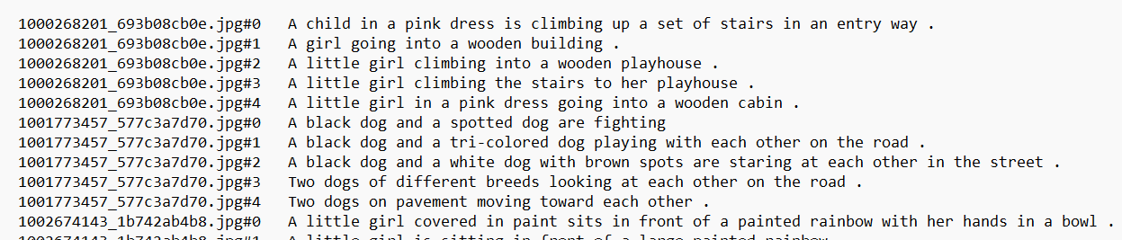
Current Status
Trained model on a small 8K Flickr Dataset for auto-captioning → results are…sub-optimal (so far!)
Flask framework for connecting to the eventual front end
Demo (?)
Text file from Flickr8K dataset - linking image name with caption

Slide 5
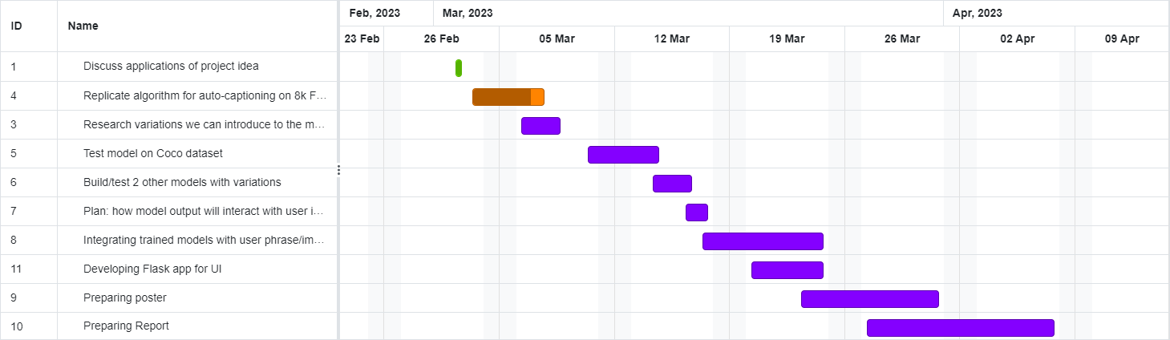
Progress Schedule

Slide 6
Future Work
Improve model
Train model on larger data-set (30k Flickr dataset, Microsoft COCO)
Use different pre-trained image classification models (VGG-16, Resnet, AlexNet)
Find methods to effectively test the different image-captioning models
Integrating output of image captioning model with unlabeled dataset + user input
Isolate important tokens/keywords from output
Using text similarity metrics to determine which images are similar to user input (phrase or image)
Building front-end

